Slide 1
THE PRODUCT LIFE CYCLE
SERM #51

Slide 2
Product Life Cycle
Growth
Maturity
Decline
Introduction

Slide 3
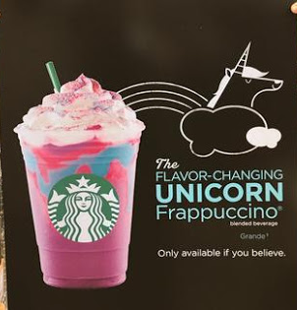
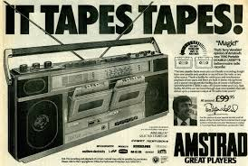
Stage 1: Introduction
Stage 1: Introduction
  Occurs when product first enters marketplace
  Promoting consumer awareness
  Getting customers to try new product
  Millions of dollars spent to educate consumers
  Major task: getting product in the marketplace

Slide 4
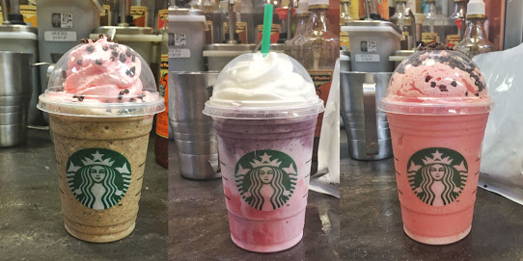
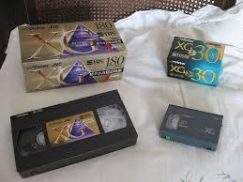
Stage 2: Growth
Stage 2: Growth
  More competitors enter the marketplace
  Adding distribution outlets
  Product improves:
    adding flavors, features, etc.
  Improved to stay competitive
  Sold in more locations

Slide 5
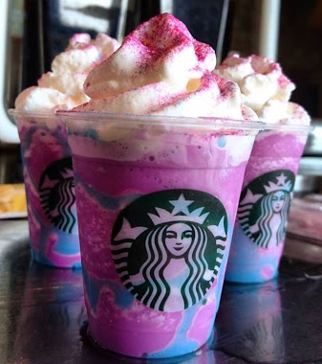
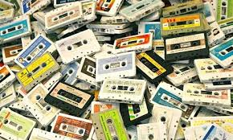
Stage 3: Maturity Stage
Stage 3: Maturity Stage
  Sales begin to slow down for the product
  Repeat customers stop buying the product
  Attracting new buyers is a challenge
  Product has reached its peak

Slide 6
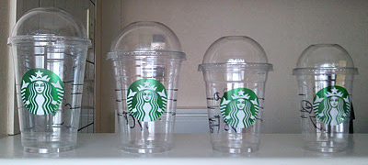

Stage 4: Decline
Stage 4: Decline
  Sales and profits drop
  Little to no marketing support
  Product may be dropped by company
  There is no longer a demand for the product

Slide 7
The Product Life Cycle Review
Introduction
Growth
Decline
Maturity

Slide 8
Manage the Life Cycle
Product Modification:
  Changing a product’s characteristics
    package, features, appearance, quality
  Companies market this “new” product to increase sales
Market Modification:
  Strategy to find new customers
    Modify the product to create new target market
  Encourage current customers to use the product more
Repositioning:
  Change product’s image in relation to competitor’s image
  A change in any of the 4 P’s (Marketing Mix)

Slide 9
Star Wars Product Life Cycle Example
Introduction-Star Wars released in 1977
Growth-More movies made from 1st one
Maturity-Sales slow after third movie
Decline-New generation does not care for movies

Slide 10
Class Activity
Take a related Sports Entertainment product through the 4 stages of the Product Life Cycle:
  Introduction
  Growth
  Maturity
  Decline

